Slide 1
Chapter 3 RTL and HDL Register Transfer Language, Hardware Description Language
Assistant Professor
Er. Shiva Ram Dam

Slide 2
Contents:
Micro-operations and RTL
Using RTL to specify a Digital System
Specification of Digital Components
Specification and Implementation of Simple System
Introduction to VHDL: Syntax. Levels of Abstraction in Design

Slide 3
3.1 Micro-operations and RTL
Micro-operations are the basis for most sequential digital systems.
Micro-operations are simpler actions like:
Movement (copying) of data form one register, memory location, or I/O device to another
Modifying stored values
Performing arithmetic or logical functions.
It is also necessary to specify the conditions under which each transfers occurs.

Slide 4
Micro-operations
A Micro-operation , or μ-op, specifies an operation whose result is stored, typically in a register or memory location.
The operation can be as simple as copying data from one register to another, or more complex, such as adding the contents of two registers and storing the result in a third register,
When designing a sequential digital system, the designer can specify the behavior of the system first, using micro-operations and then design the hardware to match this specification.

Slide 5
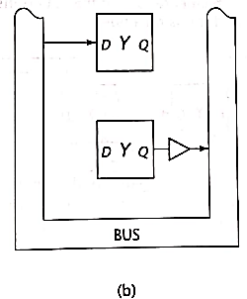
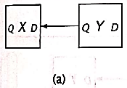
Implementations of micro-operation X←Y
Consider a digital system with two 1-bit registers, X and Y. The µop that copies the contents of register Y to register X can be expressed as X←Y.
Sometimes, this is expressed as Y→X.
The micro-operation may be implemented via a direct connection, or by way of a bus.
Both are valid implementation.
X

Slide 6
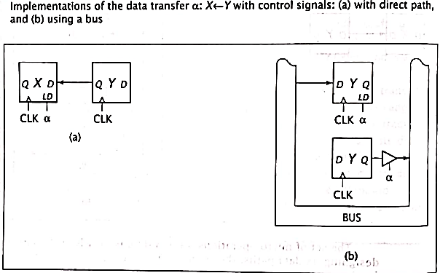
Implementations of the data transfer α : X←Y
Both designs provide a path for data to flow from register Y to register X, but neither specifies when X should load this data.
Assume that the transfer should occur when control input α is high.
The transfer could be written as:
IF α THEN X←Y
This can be written as:
α: X←Y
When all conditions to the left of the colon are asserted, the data transfers specified by the µops are performed.
α is used to load register X, and, in the bus-based implementation, to enable the tri-state buffer so that the contents of register Y are placed on the bus.
X

Slide 7
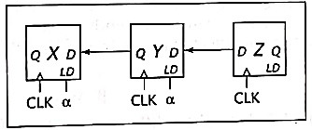
Implementations of the data transfer α : X←Y, Y←Z
One way to improve system performance is to perform two or more µops simultaneously.
The µops are separated by commas; the order in which they are written is unimportant because they are performed concurrently.
Consider:
α: X←Y, Y←Z or α: Y←Z, X←Y
If X=0, Y=1 and Z=0 just before α becomes 1, these µops set X=1(the original value of Y) and Y=0.
Note that a single bus cannot be used here because a bus can hold only one value at a time.
When α=1, both Y and Z must travel on the data paths simultaneously.
Q Z D

Slide 8
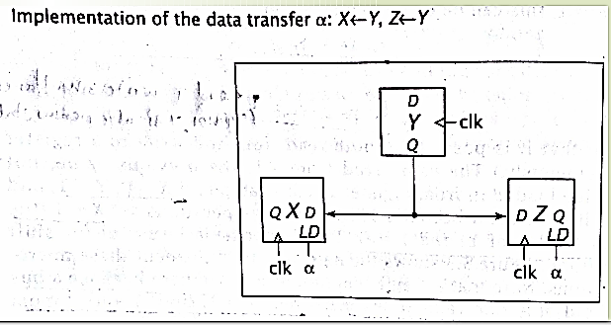
Implementations of the data transfer α : X←Y , Z←Y
Consider the transfers that occur when α = 1.
α: X←Y, Z←Y
Register Y can be read by many other registers simultaneously; both micro operations can be performed concurrently.

Slide 9
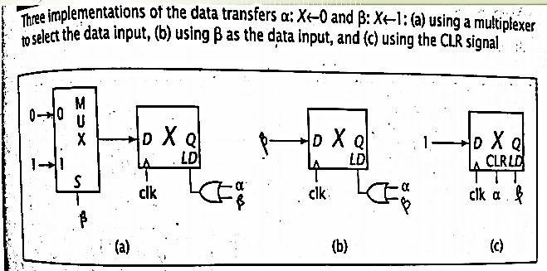
Three implementations of the data transfers α : X← 0 and β: X←1
Sometimes it is necessary to move a constant value into a register, rather than data from another register.
α: X←0
β: X←1
The first circuit sets X by loading data for both transfers.
Either α or β can assert the register’s load signal, and the MUX ensures that the proper data is made available.
If α=0 and β=0, the MUX still outputs data 0. Register X ignores this data and retains its value.
The second circuit loads data exactly same as in the first circuit;
However, its data is generated directly by signal β.
When , β=0 and α=1, register X loads 0
When , β=1 and α=0, register X loads 1
When , β=0 and α=0, register X ignores the input 0, and retains its value.
The final circuit makes use of the register’s clear input to simplify the hardware.
When α=1, register X is cleared, i.e set to 0.
When β=1, the register is loaded with the data value 1 as before.
a) Using a multiplexer to select the data input
b) Using β as the data input
c) Using the CLR signal

Slide 10
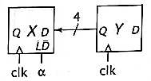
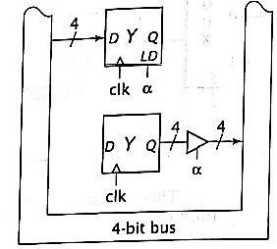
Implementations of the 4-bit data transfer α:X← Y
All of the operations so far dealt are with individual 1-bit registers.
Real systems use multibit registers to store larger data values.
For eg: consider the case, when α=1 in which data is transferred from 4-bit register Y to 4-bit register X, this can be represented as: α: X← Y
Sometimes it is necessary to access individual bits or groups of bits within a register. Individual bits can be referred to by subscripts, such as X₃ or Y₂.
Groups of bits can be referred to as ranges in RTL as X(3-1) or X(3:1)
Below statements are valid:
α : X(3-1) ← Y(2-0)
β : X₃←X₂
𝜏 : X(3-0) ← X(2-0), X₃
a) Using a direct connection
X
b) Using a bus

Slide 11
Types of Micro-operations
In digital computer, there are four types of micro-operations:
Arithmetic Micro-operations
Register Transfer Micro-operations
Logical micro-operations
Shift Micro-operations

Slide 12
1. Arithmetic micro-operation
Used to perform some basic arithmetic operation.
Eg. R1 ← R1+R2
R ← R+1
R ← R-1
R3 ← 1’s complement of R3 + 1
3. Logic micro-operation
Bitwise logical operation are performed; i.e. perform bit manipulation operation on data stored in registers.
Eg. AND, OR, NOT, EX-OR, EX-NOR, etc.
Eg: X←X^Y
2. Register transfer micro-operation
Used to transfer content of register
Eg. R1 ← R2 content of R2 transferred to R1
4. Shift micro-operation
Serial transfer or bits in a register is called shift operation.
Left shift/ right shift
Arithmetic right shift
Circular shift
Eg: R1 ← shr (R1)
R1 register will be logically shifted right, and the result will be stored in register R1.

Slide 13
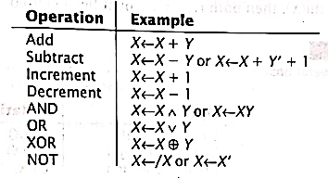
Arithmetic and Logical Micro-operations

Slide 14
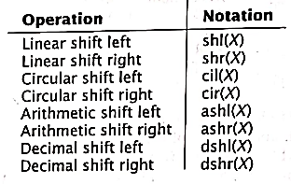
Shift Micro-operations
There are four basic types of shift Micro-operations:
Linear shift
Circular shift
Arithmetic shift
Decimal shift

Slide 15
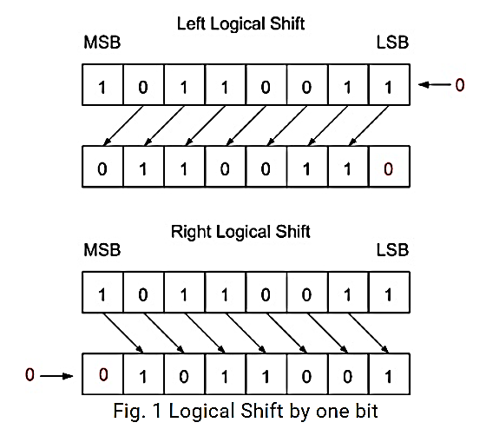
a) Linear / Logical shift
It transfers 0 by the serial input.
The symbol "shl" can be used for logical shift left and "shr" can be used for logical shift right.
R1 ← shl (R1)
R2 ← shr (R2)
The register symbol should be the equivalent on both sides of the arrows.

Slide 16
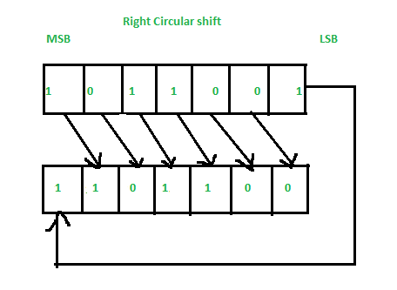
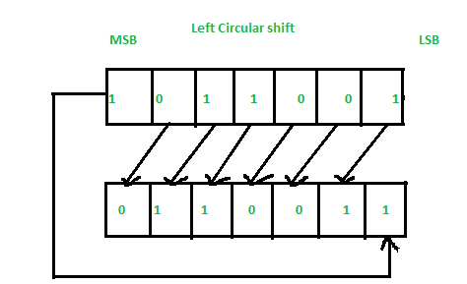
b) Circular shift
Symbolic Designation | Description
R ← shl (R) | Shift-left register R
R ← shr (R) | Shift-right register R
R ← cil (R) | Circular shift-left register R
R ← cir (R) | Circular shift-right register R
R ← ashl (R) | Arithmetic shift-left R
R ← ashr (R) | Arithmetic shift-right R
This circulates or pivots the bits of register around the two ends without any trouble of data or contents.
In circular shift, the serial output of the shift register is linked to its serial input.
"cil" and "cir" is used for circular shift left and right respectively.
The symbolic documentation for the shift micro-operations is demonstrated in the table.

Slide 17
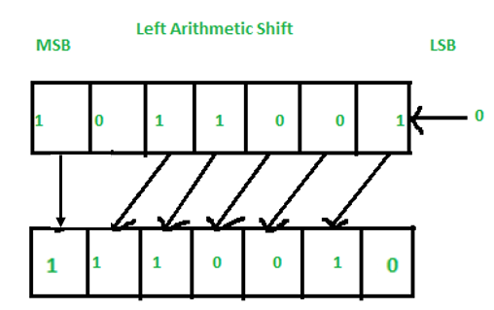
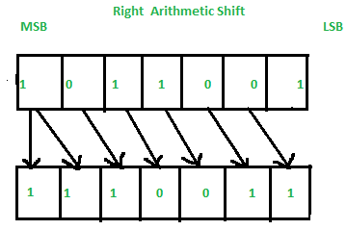
c) Arithmetic shift
This shift was developed to work with numbers that have signed formats.
This shifts a signed binary number to left or right.
In such, the sign bit remains unchanged. Otherwise, it is similar to the logical shift.
For eg: X=1011
Arithmetic Left shift yields: 1110. Here, the value of the second MSB is lost.
Arithmetic Right shift yields: 1101. Here, the LSB is lost.

Slide 18
d) Decimal Shift
Decimal shift was developed specifically for BCD representation.
It acts like a linear shift, except it shifts one digit, or four bits, instead of just one bit.
For eg: X= 1001 0111
The decimal shift left results in the value 0111 0000
The decimal shift right results in the value 0000 1001

Slide 19
Assignment:
For X= 1011 1011 1000 1010, show the result of the following operations.
shl(x)
shrl(x)
cil(x)
cir(x)
ashl(x)
ashr(x)
dshl(x)
dshr(x)

Slide 20
3.2 Using RTL to specify a Digital System
RTL can be used to specify the behavior of any sequential digital system, simplest to complex.
RTL specify the function of digital components and simple systems.

Slide 21
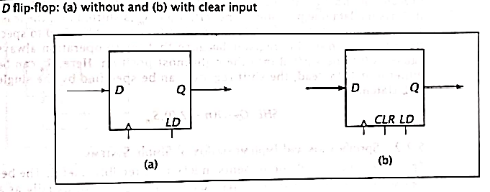
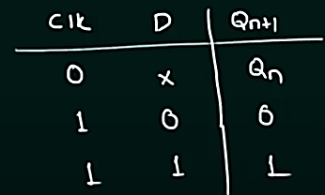
3.3 Specification of Digital Components
Consider the D flip-flop as shown in figure (a).
Its function can be expressed by single RTL statement.
LD: Q←D
When LD input is high, the value on the D input is loaded and made available on the Q output. This happens on rising edge of clock pulse.
D Flipflop truth table

Slide 22
In figure b, when CLR =1, the flipflop set to 0.
i.e.
LD: Q← D
CLR: Q←0
However, When D, LD and CLR are equal to 1, the above system fails.
When LD=1, the Q is set to 1
And when CLR=1, Q is clear to 0,
Both set Q simultaneously.
Which is not possible.
D Flipflop truth table

Slide 23

The solution is to modify the conditions so they are mutually exclusive.
Either of the following is valid.
In this RTL code, note the combined condition in the RTL statement.
It is possible to require more than one condition to be met in order for a micro-operation to occur.
Here, Q is set to 1 if both CLR=0 and LD=1.
D Flipflop truth table

Slide 24
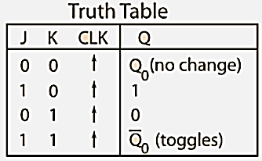

Another Example: JK
Consider the JK flip flop without a CLR input.
Its truth table is:
Its behavior can be specified in RTL as follow:
When J=0 and K=0, no condition is met and the flip-flop retains its previous value. No RTL statement is included for this case because no transfer is needed.

Slide 25
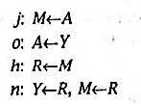
3.4 Specification and Implementation of Simple Systems
RTL can be used to specify behavior of an entire system , independent of the components used to implement the system.
Consider a system with four 1-bit flipflops. Given RTL code where j, o, h and n are conditions which are mutually exclusive.

Slide 26
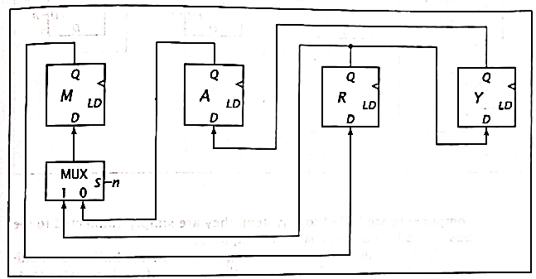
This RTL can be implemented using direct connections.

Slide 27
But it does not complete the transfer.
No register has actually loaded any data yet.
It is necessary to assert LD signal.

Slide 28
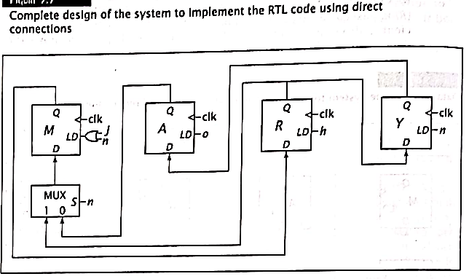
The complete circuit, with LD signal is shown as below.
The flipflop M is loaded when j=1 (M←A) or n=1 (M←R).
Logically, ORing these signals together produces LD input for M flipflop.
Similarly for other conditions.

Slide 29
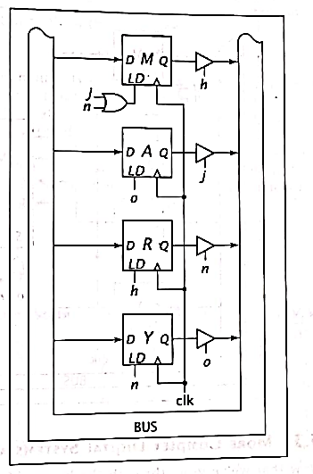
Buses can be implemented using either tri-state buffers or multiplexers.
Figure aside shows the complete design of the system to implement RTL code using a bus and tri-state buffers.

Slide 30
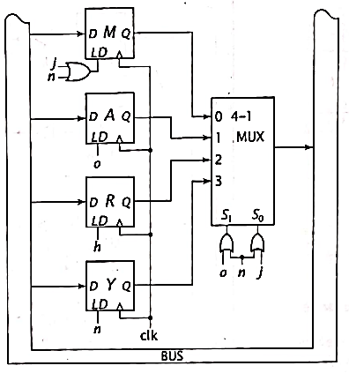
It is also possible to implement a system bus using a multiplexer.
MUX can be used instead of tri-state buffers.
n o j

Slide 31
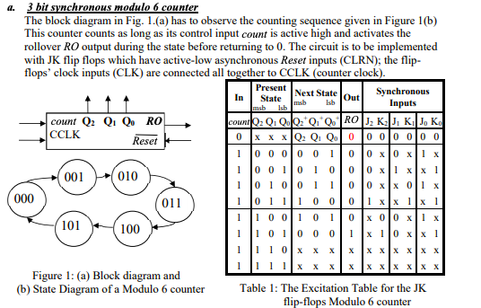
Modulo 6 Counter
To design a modulo 6 counter, first, we need to specify the function of counter using RTL.
Then, we implement RTL code using digital logic.
The modulo 6 counter is a 3 bit counter that counts through the sequence:
Its input U controls the counter.
When U=1, the counter increments its value on the rising edge of the clock.
When U=0, it retains its current value of the clock.
The value of count is represented as 3-bit output V₂V₁V₀.
An additional output, C is 1 when going from 5 to 0, and
0 otherwise.
In this example, C output remains at 1 until the counter goes from 0 to 1.

Slide 32
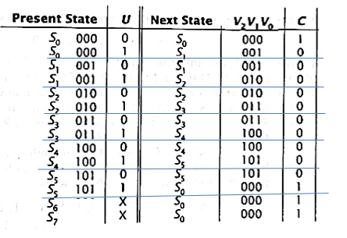
State table for Modulo 6 counter:
The additional states S6 and S7 are to handle the case when mod-6 counter powers up in invalid state.

Slide 33
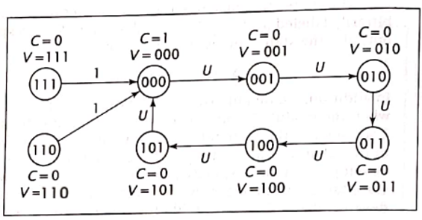
State diagram

Slide 34
When the counter’s value is 000 to 100 and its U(up) signal is asserted, the output of the counter is incremented.
This corresponds to condition (S₀+S₁+S₂+S₃+S₄)U.
Under this condition, C is also set to 0.
So V←V+1, C←0
Thus (S₀+S₁+S₂+S₃+S₄)U : V←V+1, C←0
When counter is in state S₅ (V=101) and U=1, the counter must be reset to 000 and C must be 1,
i.e. S₅ U : V← 0, C← 1
For invalid state, regardless of value of U,
(S₆+S₇) : V←0, C←1
Thus the behavior of the modulo 6 counter can be expressed by RTL as:
(S₀+S₁+S₂+S₃+S₄)U : V←V+1, C←0
S₅ U+ S₆+S₇: V←0, C←1

Slide 35
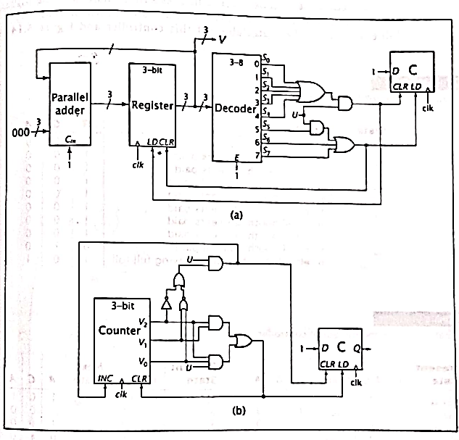
(S₀+S₁+S₂+S₃+S₄)U : V←V+1, C←0
S₅U+S₆+S₇ : V←0, C←1
Figure shows the RTL code implementation using a register.
This uses a 3-bit parallel adder to generate V+1 and sets C separately.
Notice that the decoder converts V₂V₁V₀ to the state values S0 to S7.

Slide 36
Another way of implementation is the use of a counter.
This implementation uses a 3-bit counter.
C is set to 1 either when counting from 101 to 000 or when it is reset from an invalid state.

Slide 37
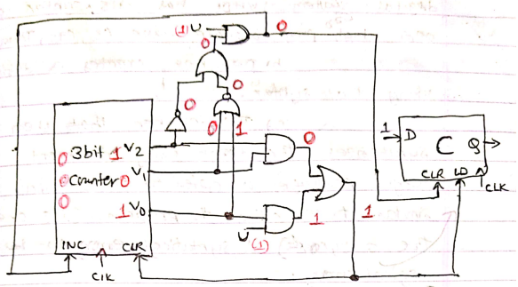

Slide 38
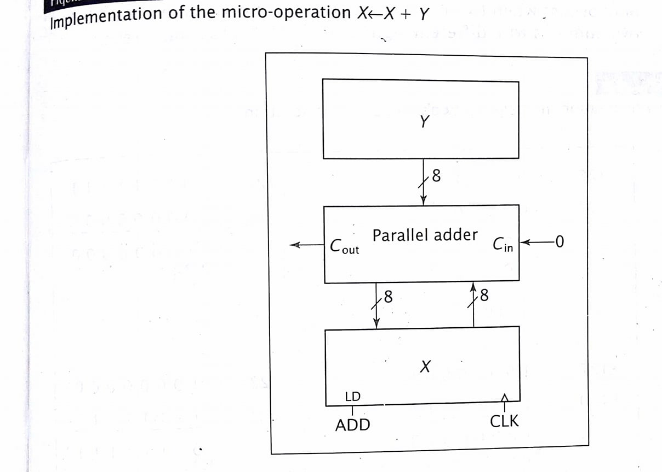
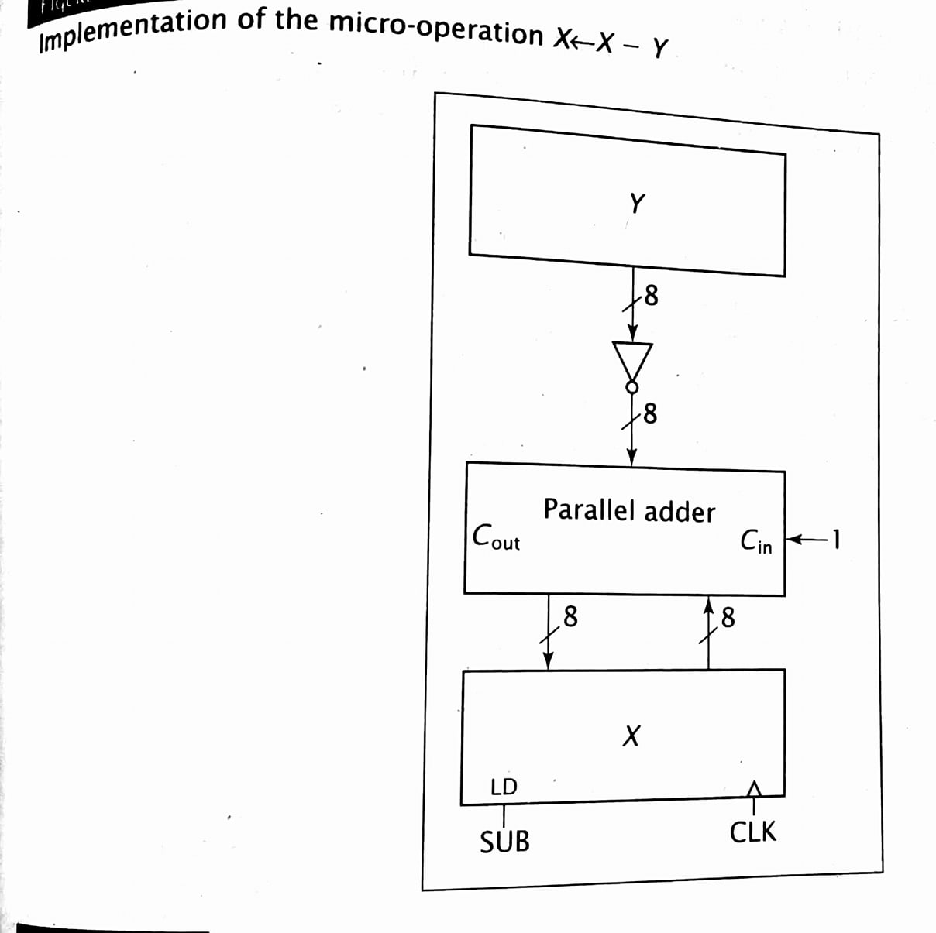

Slide 39
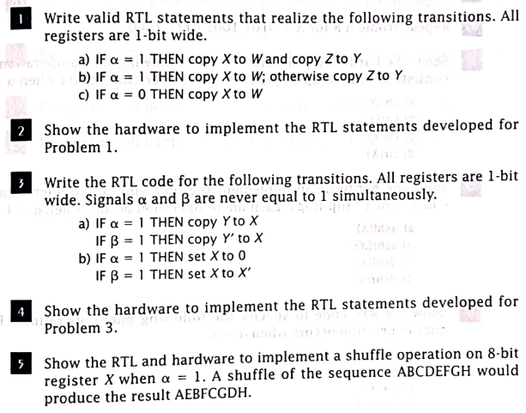
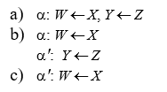
Problems and Solutions

Slide 40
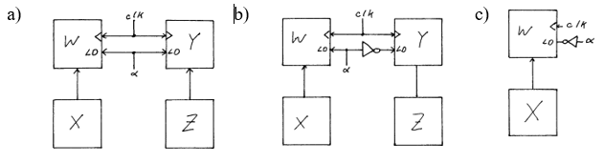

Slide 41
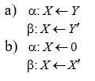
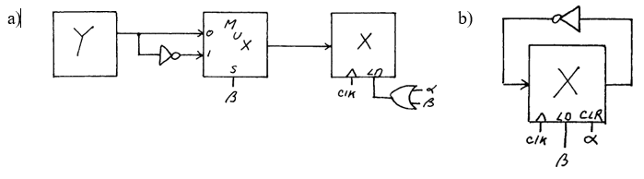

Slide 42
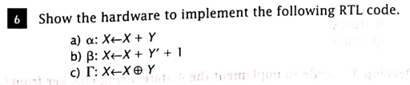
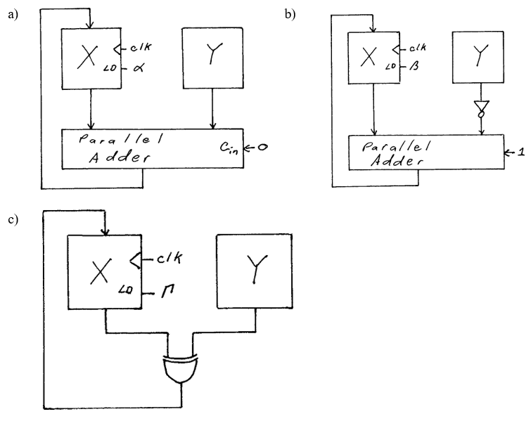

Slide 43
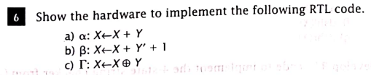
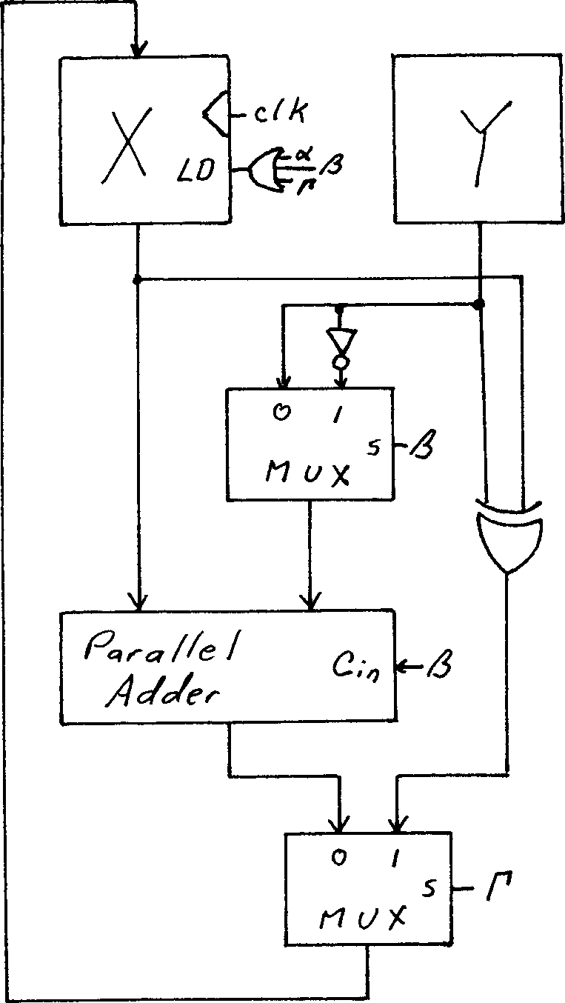


Slide 44
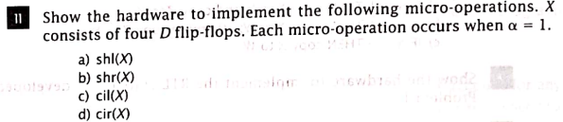
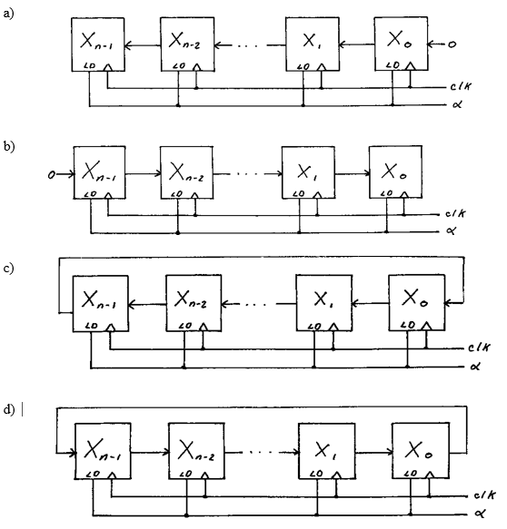

Slide 45

Assignment:
Implement the given RTL codes into a single system using bus. . [PU 2017 Fall]
R1← R2, R3← R2
R2 ← R3
R3 ← R1, R2←R1
Perform the circular left shift, circular right shift, linear left shift, arithmetic left shift and arithmetic right shift operations on a register holding the value 10100100. [PU 2017 Spring]
Define RTL. Perform eight different shift operations on X= 110001010001
List out the RTL code for arithmetic and logical operations. Also show the implantation of addition and subtraction using parallel adder. [PU 2018 Fall]
Define RTL. Write RTL codes for arithmetic operations with circuitry. [PU 2018 Spring]
Design a system that could implement the given RTL codes sing direct connection: [PU 2019 Spring]

Slide 46
VHDL
Very high speed integrated circuit (VHSIC) Hardware Description Language (VHDL)
VHDL was developed to provide a standard for designing digital systems.
VHDL specifies a formal syntax. The designer creates a design file using that syntax just as a programmer writes a C-program.
The designer then synthesizes the design using only design package that can accept VHDL files. This is equivalent to the programmer compiling the C-program. It checks for errors in syntax and declaration, but not in logic.
Finally, the designer debugs the design using simulation tools

Slide 47
Advantages of VHDL:
PORTABILITY: Just as a valid C-program can be compiled by any compliant C compiler, a VHDL design can be synthesized by any design system that supports VHDL.
DEVICE INDEPENDENT: The VHDL file is device independent. The same file can be used to implement the design on a custom ICs, on ASICs or any PLD that is capable of containing the design.
SIMULATION: VHDL designs can be simulated by the design system, allowing the designer to verify the design performance before committing it to hardware.
SYSTEM SPECIFICATION: The designer can design the system using a high level of abstraction, such as a finite state machine, down to a low level digital logic implementation.

Slide 48
Advantages of VHDL:
Summary:
VHDL is used to design ICs and application specific ICs (ASICs), PLD.
VHDL offers portability. VHDL can be synthesized by any design system supported by VHDL.
VHDL files are device independent.
VHDL designs can be simulated.
VHDL files provide good documentation of system design.

Slide 49
Disadvantages of VHDL:
VHDL source code often becomes long and difficult to follow, especially at a low level of abstraction.
It is often less intuitive than a block diagram or RTL description of same system.
Different design tools may produce different valid design for the same system, especially for high level of abstraction, providing no details about the implementation
Summary:
VHDL source code often are long and difficult to follow at low level of abstraction.
VHDL are difficult to understand.
VHDL does not provide detail about its design implementation.

Slide 50
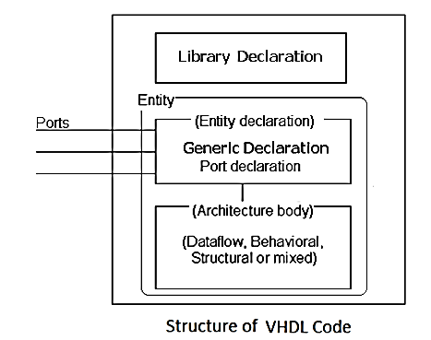
VHDL syntax:
VHDL design code has 3 primary sections:
Library declarations
Entity section and
Architecture section

Slide 51
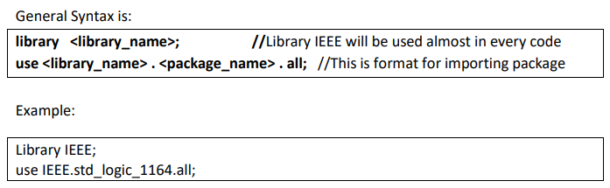
i) Library declaration:
It consists of statements that specify libraries to be accessed and modules of these libraries to be used.(such as “include” in C)
The most commonly used library is called IEEE.
In this library, std_logic_1164 is used most often, which specifies i/p and o/p declarations for the designer to use (such as “stdio.h” in C).

Slide 52
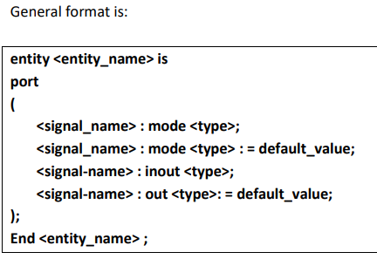
ii) Entity section:
In the entity section, the designer specifies the name of the design and its inputs and outputs.
The designer does not specify the logic that uses and drives these signals here; that is done in the architecture section.

Slide 53
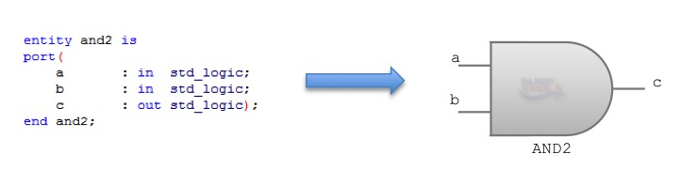
VHDL Entity representing an “And gate” with two input ports a and b and output port c.

Slide 54
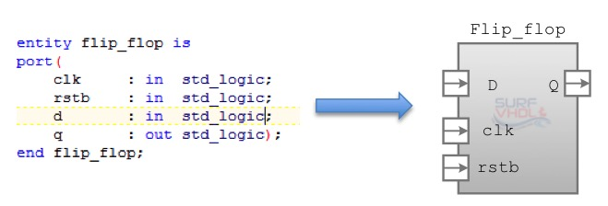
VHDL Entity representing a flip-flop type D with input port: clock and reset active low, data D, and output port Q.

Slide 55
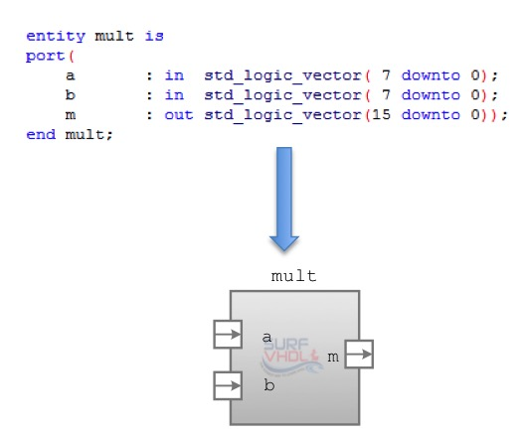
VHDL Entity representing a multiplier with input operand a and b of 8 bit and output m of 16 bit.

Slide 56
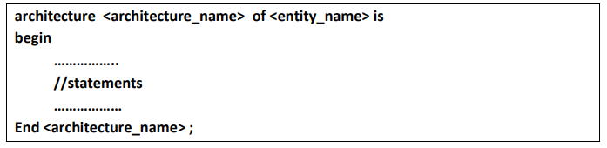
iii) Architecture Section:
This is the final section .
This section specifies the behavior and internal logic of system under design.
The basic format is:

Slide 57
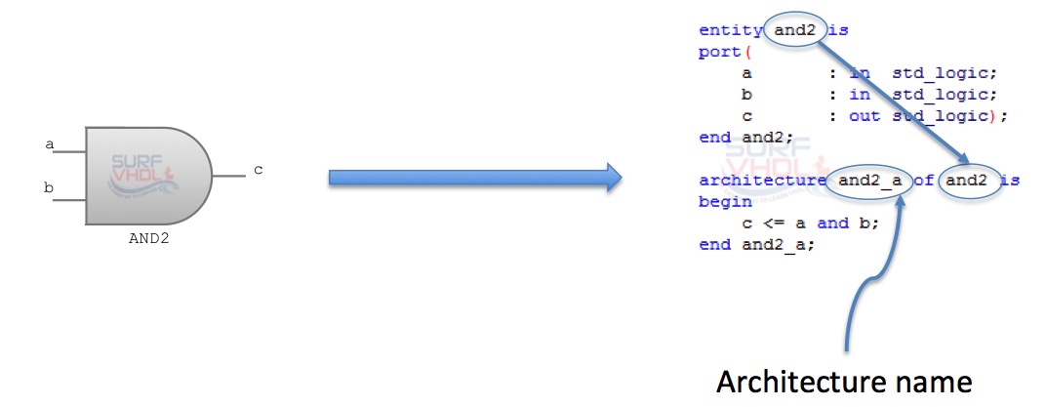
iii) Architecture Section:

Slide 58
Different types of Modeling to describe architecture:
Behavioral Modeling
Structural Modeling
Data flow Modeling
Mixed Modeling

Slide 59
i) Behavioral Modeling
In Behavioral modeling, we describe a system in terms of what it does or how it behaves rather than in terms of its component and interconnection between them.
Such description specifies the relationship between input and output signal.

Slide 60
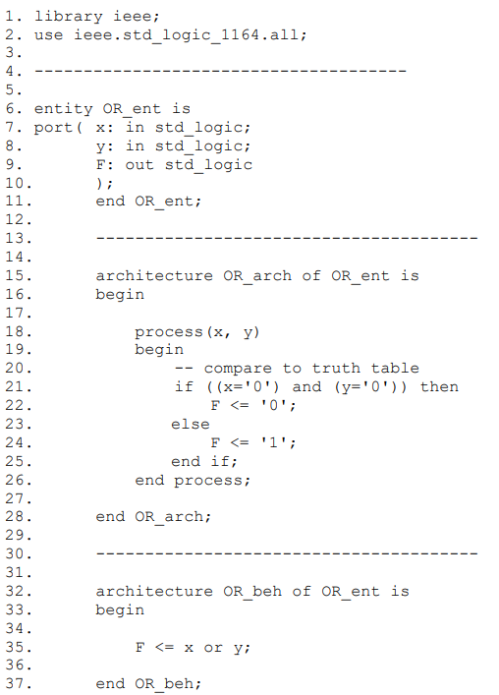
a) OR gate:

Slide 61

b) AND gate

Slide 62


c) XOR gate

Slide 63




d) VHDL concurrency
It is clear that the same result will be evaluated from this implementation

Slide 64


e) VHDL Code for half-adder using dataflow via logic equation

Slide 65

ii) Structural Modeling
In structural modeling, different interconnection of different components are described.
If you are designing a complex project, you should split in two or more simple design in order to easy handle the complexity.

Slide 66
begin
u1: AND2 portmap (x=>a, y=> b, z=> c);
u2: AND2 portmap (x=>d ,y=>e, z=> f);
u3: OR2 portmap (p=>c, q=>f, z<= g);
end structure
architecture structure of ckt is
component AND2
port
(x, y: in std_logic;
z: out std_logic);
)
end component;
component OR2
port
(p, q: in std_logic;
r: out std_logic);
)
end component;
signal c, f : std_logic;
library IEEE;
use IEEE.std_logic_1164.all;
entity ckt is
port
(a, b, d, e : in std_logic;
g: out std_logic);
end ckt;

Slide 67



Slide 68


Slide 69
VHDL design with high level of abstraction
A high level of abstraction is a finite state machine description of a system (using MUX, decoder, ROM)
A low level of abstraction is a digital logical implementation (using gates)
The design of modulo 6 counter as a finite state machine is high level of abstraction.

Slide 70
VHDL design with high level of abstraction
For Modulo 6 counter

Slide 71
(S₀+S₁+S₂+S₃+S₄)U : V←V+1, C←0
S₅U+S₆+S₇ : V←0, C←1

Slide 72


VHDL file to implement Modulo 6 counter using a high level of abstraction
(S₀+S₁+S₂+S₃+S₄)U : V←V+1, C←0
S₅U+S₆+S₇ : V←0, C←1

Slide 73

Explanation:
To declare the VHDL design for this counter, we begin with the library declarations and entity section.
In the library declarations, we will only need the standard IEEE library and its std_logic 1164 module.
In the entity section, we declare the system’s inputs and outputs.
The modulo 6 counter has two inputs. U and the system clock which we label clk.
It has 1-bit output C and 3-bit output V.
We define V as a 3-bit vector with indices 2, 1 and 0.
The library declarations and entity section of this design are:

Slide 74

Now we must develop the architecture section of the modulo 6 counter.
But before specifying the system's behavior, the architecture declares a new enumerated type, states.
This type has eight possible values, S₀ to S₇, which correspond to the six valid and two invalid sates of the counter.
It declares two signals: present_state and next_state, to be of this type.

Slide 75

Beyond these declarations, we partition this design into two processes.
The first looks at the present state of the counter and its input values, and generates the desired outputs and next state value.
The second process makes the actual transition from the present state to the next state.
The first procedure is names state_mod6. it uses a case statement.

Slide 76

The second process is state_transition.
On the rising edge of the clock it copies the next_state value generated bus process state_mod6 to present_state.
Although state_mod6 generates the next state value, the transition to this state occurs in process state_transition.
Once the new value of present_state is set, it is used by state_mod6 to select the next value for the case statement.
The code for this module is:

Slide 77

Low Level of Abstraction
library IEEE;
use IEEE.std_logic_1964.all;
entity mod6 is
port
(
U, clk : in std_logic;
q2 , q1, q0 : buffer std_logic;
v2, v1, v0, C: out std_logic);
end mod6;
architecture amod6 of mod6 is
begin
cct_mod6 : process (q2, q1, q0, U,clk)
begin
if rising_edge (clk) then
q2<= q2 and (not q1) and (not U)) or ((not q2) and q1 and q0 and U);
q1<=((not q2) and q1 and (not q0)) or ((not q2) and q1 and (not q0)) or ((not q2) and (notq1) and q0 and U);
q0<=((not q2) and (not q0) and U) or ((notq2) and q0 and (not U)) or ((not q1) and q0 and (not U));
end if;
v2<=q2;
v1<=q1;
v0<= (q2 and q1) or q0;
c <= not (q2 or q1 or q0);
End process cct_mod6;
end amod6;
C

Slide 78



All code at once

Slide 79



VHDL code for Full adder (Low level abstraction)

Slide 80


VHDL code for D-Flip flop

Slide 81




Slide 82

Assignment:
Write a VHDL code for generating the combinational circuit with three inputs A, B and C and output F=(A^B) v A’ v (A’ ^B’). [PU 2017 Fall]
Write a VHD code to generate a function F= ABC + A’B’C’. [PU 2018 Spring]
Write a VHDL code for generating the combinational circuit for a function F(x, y, z) $=\sum{(1,3,4,6)}$. [PU 2017 Spring]
Write a VHDL code for generating the combinational circuit with three inputs A, B, C and an output F, where F(A, B, C) $=\sum{(1,3,4,6)}$. [PU 2018 Fall]
Write VHDL code for designing a full adder using half adder in structural model. [PU 2020 Spring]

Slide 83

Assignment:
Write a VHDL code for generating the combinational circuit with three inputs A, B and C and output F=(A^B) v A’ v (A’ ^B’). [PU 2017 Fall]
Write a VHDL code for generating the combinational circuit for a function F(x, y, z) $=\sum{(1,3,4,6)}$. [PU 2017 Spring]
Write a VHDL code for generating the combinational circuit with three inputs A, B, C and an output F, where F(A, B, C) $=\sum{(1,3,4,6)}$. [PU 2018 Fall]
Write a VHD code to generate a function F= ABC + A’B’C’. [PU 2018 Spring]
Write VHDL code for designing a full adder using half adder in structural model. [PU 2020 Spring]

Slide 84
Partial End
of
chapter 3

Slide 85
Some References for VHDL code

Slide 86
Some more about VHDL
Assistant Professor
Er. Shiva Ram Dam

Slide 87
Contents:
Background and basic concepts
Structural specification of hardware and design organization
VHDL realization of basic digital circuits
Binary adder
Multiplier
Decoder
Multiplexer
Counters
Shift Registers
Sequence Detectors

Slide 88
8.1 VHDL
Very high speed integrated circuit (VHSIC) Hardware Description Language (VHDL)
VHDL was developed to provide a standard for designing digital systems.
VHDL specifies a formal syntax. The designer creates a design file using that syntax just as a programmer writes a C-program.
The designer then synthesizes the design using only design package that can accept VHDL files. This is equivalent to the programmer compiling the C-program. It checks for errors in syntax and declaration, but not in logic.
Finally, the designer debugs the design using simulation tools

Slide 89
Advantages of VHDL:
PORTABILITY: Just as a valid C-program can be compiled by any compliant C compiler, a VHDL design can be synthesized by any design system that supports VHDL.
DEVICE INDEPENDENT: The VHDL file is device independent. The same file can be used to implement the design on a custom ICs, on ASICs or any PLD that is capable of containing the design.
SIMULATION: VHDL designs can be simulated by the design system, allowing the designer to verify the design performance before committing it to hardware.
SYSTEM SPECIFICATION: The designer can design the system using a high level of abstraction, such as a finite state machine, down to a low level digital logic implementation.

Slide 90
Advantages of VHDL:
Summary:
VHDL is used to design ICs and application specific ICs (ASICs), PLD.
VHDL offers portability. VHDL can be synthesized by any design system supported by VHDL.
VHDL files are device independent.
VHDL designs can be simulated.
VHDL files provide good documentation of system design.

Slide 91
Disadvantages of VHDL:
VHDL source code often becomes long and difficult to follow, especially at a low level of abstraction.
It is often less intuitive than a block diagram or RTL description of same system.
Different design tools may produce different valid design for the same system, especially for high level of abstraction, providing no details about the implementation

Slide 92
Disadvantages of VHDL:
Summary:
VHDL source code often are long and difficult to follow at low level of abstraction.
VHDL are difficult to understand.
VHDL does not provide detail about its design implementation.

Slide 93
8.2 VHDL Structure:
VHDL design code has 3 primary sections:
Library declarations
Entity section and
Architecture section

Slide 94
i) Library declaration:
It consists of statements that specify libraries to be accessed and modules of these libraries to be used.(such as “include” in C)
The most commonly used library is called IEEE.
In this library, std_logic_1164 is used most often, which specifies i/p and o/p declarations for the designer to use (such as “stdio.h” in C).

Slide 95
ii) Entity section:
In the entity section, the designer specifies the name of the design and its inputs and outputs.
The designer does not specify the logic that uses and drives these signals here; that is done in the architecture section.

Slide 96
VHDL Entity representing an “And gate” with two input ports a and b and output port c.

Slide 97
VHDL Entity representing a flip-flop type D with input port: clock and reset active low, data D, and output port Q.

Slide 98
VHDL Entity representing a multiplier with input operand a and b of 8 bit and output m of 16 bit.

Slide 99
iii) Architecture Section:
This is the final section .
This section specifies the behavior and internal logic of system under design.
The basic format is:

Slide 100
iii) Architecture Section:

Slide 101
Different types of Modeling to describe architecture:
Data flow Modeling
Dataflow describes how the circuit signals flow from the inputs to the outputs.
Behavioral Modeling
This model describes a system in terms of what it does or how it behaves rather than in terms of its component and interconnection between them.
Structural Modeling
In structural modeling, different interconnection of different components are described.

Slide 102
i) Dataflow Modeling
Dataflow describes how the circuit signals flow from the inputs to the outputs.
A dataflow model specifies the functionality of the entity without explicitly specifying its structure.
The functionality shows the flow of information through the entity, which is expressed primarily using concurrent signal assignment statements and block statements.

Slide 103

1. Write VHDL code for AND gate (using dataflow model)

Slide 104

2. Write VHDL code for Half Adder (using Dataflow model)

Slide 105
3. Write VHDL concurrency coding for below circuit (using dataflow model)
It is clear that the same result will be evaluated from this implementation

Slide 106

4. Write VHDL code for Full adder (using dataflow model)

Slide 107
ii) Behavioral Modeling
In Behavioral modeling, we describe a system in terms of what it does or how it behaves rather than in terms of its component and interconnection between them.
Such description specifies the relationship between input and output signal.
This style specifies the behavior of an entity as a set of statements that are executed sequentially in the specified order.

Slide 108
5. Write VHDL for OR gate (using behavioral model)

Slide 109
6. Write VHDL for AND gate (using behavioral model)

Slide 110
7. Write VHDL for OR gate (using behavioral model)

Slide 111
ii) Structural Modeling
In structural modeling, different interconnection of different components are described.
If you are designing a complex project, you should split in two or more simple design in order to easy handle the complexity.

Slide 112
8. Write VHDL for below combinational circuit (using structural model but no behavioral/dataflow specified)
library IEEE;
use IEEE.std_logic_1164.all;
entity ANDgate is
port
(a, b, d, e : in std_logic;
g: out std_logic);
end ckt;
component OR2
port
(p, q: in std_logic;
r: out std_logic);
end component;
architecture structure of ckt is
component AND2
port
(x, y: in std_logic;
z: out std_logic);
end component;
signal c, f : std_logic;
begin
u1: AND2 port map (a, b, c);
u2: AND2 port map (d ,e, f);
u3: OR2 port map (c, f, g);
end structure

Slide 113
Assignment:
9. Write VHDL code for below circuit using structural modeling.

Slide 114


10. Write VHDL code for below (using just structural model)

Slide 115
8.3 VHDL realization of basic digital circuits
Binary adder
Multiplier
Decoder
Multiplexer
Counters
Shift Registers
Sequence Detectors

Slide 116
8.3.1 Binary adders

Slide 117

11. Write a VHDL code to implement the half adder using structural modeling or component.

Slide 118


Solution:

Slide 119

12. Write a VHDL code to implement the full-adder using two half adders.

Slide 120




Solution:
b2
b3
b1
b3;

Slide 121

13. Write VHDL code for 4-bit binary parallel adder.

Slide 122

---------------------------------------------
--VHDL code for Parallel Adder
------------------------------------------- entity PA is port( a : in STD_LOGIC_VECTOR(3 downto 0); b : in STD_LOGIC_VECTOR(3 downto 0); carry : out STD_LOGIC; sum : out STD_LOGIC_VECTOR(3 downto 0) ); end PA; architecture PA_arch of PA is Component FA is port ( a, b, c : in STD_LOGIC; sum , carry : out STD_LOGIC ); end component; signal c : std_logic_vector (3 downto 1); begin u0 : FA port map (a(0) , b(0) , ‘0’ , sum(0) , c1)); u1 : FA port map (a(1) , b(1) , s(0) , sum(1) , c2); u2 : FA port map (a(2) , b(2) , s(1) , sum(2) , c3); u3 : FA port map (a(3) , b(3) , s(2) , sum(3) , carry); end PA_arch ;
library IEEE; use IEEE.STD_LOGIC_1164.all;
---------------------------------------------
--VHDL code for Full Adder
------------------------------------------- entity FA is port ( a : in STD_LOGIC; b : in STD_LOGIC; c : in STD_LOGIC; sum : out STD_LOGIC; carry : out STD_LOGIC ); end FA;
architecture FA_arc of FA is begin sum <= a xor b xor c; carry <= (a and b) or (b and c) or (c and a); end FA_arc;

Slide 123
8.3.2 Multiplier

Slide 124

14. VHDL for 2 bit binary multiplier using dataflow modeling
library ieee;
use ieee.std_logic_1164.all;
entity multiply is
port (A, B : in bit_vector(1 downto 0);
P : out bit_vector(3 downto 0)
);
end multiply;
architecture dataflow of multiply is
begin
P(0) <= A(0) AND B(0);
P(1) <= (A(1) AND B(0)) XOR (A(0) AND B(1));
P(2) <= ((A(1) AND B(0)) AND (A(0) AND B(1))) XOR (A(1) AND B(1));
P(3) <= ((A(1) AND B(0)) AND (A(0) AND B(1))) AND (A(1) AND B(1));
end architecture;
Fig: The logic circuit of a 2-bit binary multiplier

Slide 125
15. VHDL for 2 bit binary multiplier using behavioral modeling
library ieee;
use ieee.std_logic_1164.all;
entity multiply_behav is
port (A, B : in bit_vector(1 downto 0);
P : out bit_vector(3 downto 0)
);
end multiply_behav;
architecture behavioral of multiply_behav is
begin
process(A,B) is
begin
case A is
when "00" =>
if B="00" then P<="0000";
elsif B="01" then P<="0000";
elsif B="10" then P<="0000";
else P<="0000";
end if;
when "01" =>
if B="00" then P<="0000";
elsif B="01" then P<="0001";
elsif B="10" then P<="0010";
else P<="0011";
end if;
when "10" =>
if B="00" then P<="0000";
elsif B="01" then P<="0010";
elsif B="10" then P<="0100";
else P<="0110";
end if;
when "11" =>
if B="00" then P<="0000";
elsif B="01" then P<="0011";
elsif B="10" then P<="0110";
else P<="1001";
end if;
end case;
end process;
end architecture;

Slide 126
16. VHDL for 2 bit binary multiplier using structural modeling
library ieee;
use ieee.std_logic_1164.all;
entity AND2 is
port(
A,B: in BIT;
x : out BIT);
end AND2;
architecture behavioral of AND2 is
begin
x <= A and B;
end behavioral;
entity multiply_struct is
port (
A, B : in bit_vector(1 downto 0);
P : buffer bit_vector(3 downto 0)
);
end multiply_struct;
architecture structural of multiply_struct is
component AND2
port(
A,B: in BIT;
X : out BIT);
end component;
component half_adder
port (
A, B : in BIT;
sum, carry : out BIT);
end component;
signal S1,S2,S3,S4:BIT;
begin
A1: AND2 port map(A(0),B(0),P(0));
A2: AND2 port map(A(1),B(0),S1);
A3: AND2 port map(A(0),B(1),S2);
A4: AND2 port map(A(1),B(1),S3);
H1: half_adder port map(S1,S2,P(1),S4);
H2: half_adder port map(S4,S3,P(2),P(3));
end architecture;
entity half_adder is
port (
a, b : in BIT;
sum, carry : out BIT
);
end half_adder;
architecture arch of half_adder is
begin
sum <= a xor b;
carry <= a and b;
end arch;

Slide 127
8.3.3 Decoders

Slide 128

17. Write the VHDL code to implement 2:4 decoder
Library ieee;
use ieee.std_logic_1164.all;
entity Decoder is
port
( SW : in std_logic_vector (1 down to 0);
Q : out std_logic_vector(3 down to 0);
);
end decoder;
architecture Dec_Arch of Decoder is
begin
if (SW = “00”) then
Q<= “0001” ;
elseif (SW = “01”) then
Q<= “0010” ;
elseif (SW = “10”) then
Q<= “0100”;
else
Q<= “1000”;
Endif;
end Dec_Arch ;

Slide 129

18. Write VHDL for 4:2 Encoder
Library ieee;
use ieee.std_logic_1164.all;
entity Encoder is
port
( Q : out std_logic_vector (1 down to 0);
D: in std_logic_vector(3 down to 0);
);
end Encoder;
architecture arc_encoder of Encoder is
begin
if (D = “0001”) then
Q<= “00” ;
elseif (Q = “0001”) then
Q<= “01” ;
elseif (D= “10”) then
Q<= “10”;
else
Q<= “11”;
Endif; end arc_encoder;

Slide 130


Assignment:
Write the VHDL code to implement 3 to 8 decoder using two 2 to 4 decoder.
Write VHDL code to simulate Octal to Binary Encoder.

Slide 131
8.3.4 Multiplexers

Slide 132

21. Write VHDL code to simulate 4:1 MUX.
Library ieee;
use ieee.std_logic_1164.all;
entity MUX is
port
( Q : out std_logic;
I0,I1,I2,I3 : in std_logic;
SL: in std_logic_vector (1 down to 0);
);
end MUX;
architecture arc_MUX of MUX is
begin
if (SL= “00”) then
Q<= I0;
elseif (SL= “01”) then Q<= I1 ;
elseif (SL= “10”) then
Q<= I2;
else
Q<= I4;
Endif;
end arc_MUX;

Slide 133



22. Write VHDL code to simulate 8:1 MUX.

Slide 134

23. Write VHDL code to simulate 1:4 DEMUX.
Library ieee;
use ieee.std_logic_1164.all;
entity DMUX is
port
( Din : in std_logic;
Y0,Y1,Y2,Y3 : out std_logic;
SL: in std_logic_vector (1 down to 0);
);
end DMUX;
architecture arc_DMUX of DMUX is
begin if (SL= “00”) then
Q0<= Din;
elseif (SL= “01”) then
Q1<= Din ;
elseif (SL= “10”) then
Q2<= Din;
else
Q3<= Din;
Endif;
end arc_MUX;

Slide 135



24. Write VHDL code to simulate 1:8 DEMUX.

Slide 136
8.3.5 Flipflops

Slide 137

25. VHDL for simple D latch

Slide 138

26. VHDL for D flipflop

Slide 139


27. VHDL for JK Flipflop

Slide 140
8.3.6 Counters

Slide 141


28. VHDL for n-bit counter

Slide 142
8.3.7 Shift Registers

Slide 143


29. VHDL for n-bit register

Slide 144


30. VHDL for n-bit shift register

Slide 145
8.3.8 Sequence Detectors

Slide 146
31. VHDL program for Modulo 6 Counter

Slide 147

32. VHDL program for which output will be 1 when the sequence 1101 is detected considering overlapping condition.
elsif ( rising_edge(clk) ) then --calculates the next state based on current state and input bit.
case state is
when A => det_vld <= '0’;
if ( seq = '0' ) then
state <= A;
else
state <= B;
end if;
when B => --when the current state is B.
if ( seq = '0' ) then
state <= C;
else
state <= B;
end if;
when C => --when the current state is C.
if ( seq = '0' ) then
state <= A;
else
state <= D;
end if;
when D => --when the current state is D.
if ( seq = '0' ) then
state <= C;
else
state <= A;
det_vld <= '1’; --Output is asserted when the pattern "1011" is found in the sequence.
end if;
when others =>
NULL;
end case;
end if;
end process;
end Behavioral;
library IEEE;
use IEEE.STD_LOGIC_1164.ALL;
--Sequence detector for detecting the sequence "1011". --Non overlapping type.
entity seq_det is
port( clk : in std_logic; --clock signal
reset : in std_logic; --reset signal
seq : in std_logic; --serial bit sequence
det_vld : out std_logic --A '1' indicates the pattern "1011" is detected in the sequence.
);
end seq_det;
architecture Behavioral of seq_det is
type state_dec is (A,B,C,D); --Defines the type for states in the state machine
signal state : state_dec ; --Declare the signal with the corresponding state.
begin
process(clk)
begin
if( reset = '1' ) then --resets state and output signal when reset is asserted.
det_vld <= '0’;
state <= A;

Slide 148



33. VHDL for 101 Sequence detector

Slide 149
Some More Useful Links for VHDL coding:
https://www.engineersgarage.com/vhdl-tutorial-1-introduction-to-vhdl/
https://www.eng.auburn.edu/~nelsovp/courses/elec4200/Slides/VHDL%202%20Combinational.pdf
https://www.javatpoint.com/vhdl
https://nandland.com/introduction-to-vhdl-for-beginners-with-code-examples/
https://www.tutorialspoint.com/vlsi_design/vlsi_design_vhdl_introduction.htm
https://www.asic-world.com/vhdl/tutorial.html

Slide 150
End of chapter 3

